Slide 1
Upsampling and Downsampling
The main two methods that are used to tackle the class imbalance is upsampling/oversampling and downsampling/undersampling. The sampling process is applied only to the training set and no changes are made to the validation and testing data. Imblearn library in python comes in handy to achieve the data resampling.

Slide 2
Upsampling
Upsampling is a procedure where synthetically generated data points (corresponding to minority class) are injected into the dataset. After this process, the counts of both labels are almost the same. This equalization procedure prevents the model from inclining towards the majority class. Furthermore, the interaction(boundary line)between the target classes remains unaltered. And also, the up sampling mechanism introduces bias into the system because of the additional information.

Slide 3
Down Sampling
Downsampling is a mechanism that reduces the count of training samples falling under the majority class. As it helps to even up the counts of target categories. By removing the collected data, we tend to lose so much valuable information.
Downsampling means training on a disproportionately low subset of the majority class examples. Upweighting means adding an example weight to the downsampled class equal to the factor by which you downsampled

Slide 4
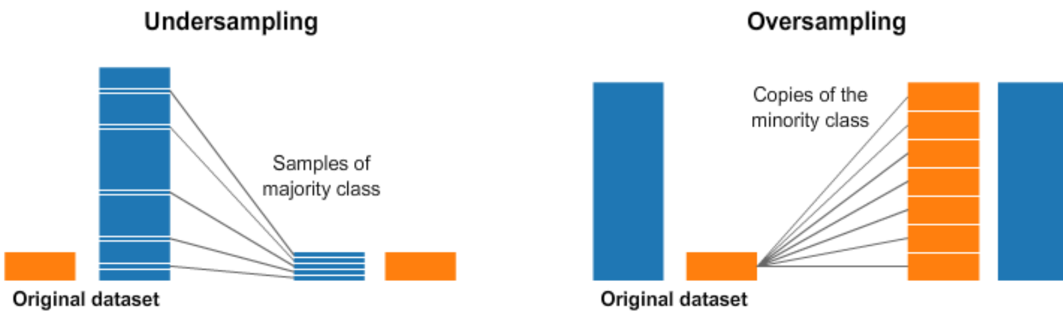
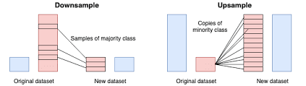

Slide 5
SMOTE
SMOTE(SyntheticMinorityOversamplingTechnique) — upsampling:- It works based on the KNearestNeighbours algorithm, synthetically generating data points that fall in the proximity of the already existing outnumbered group. The input records should not contain any null values when applying this approach.
SMOTE is an oversampling technique where the synthetic samples are generated for the minority class. This algorithm helps to overcome the overfitting problem posed by random oversampling.

Slide 6
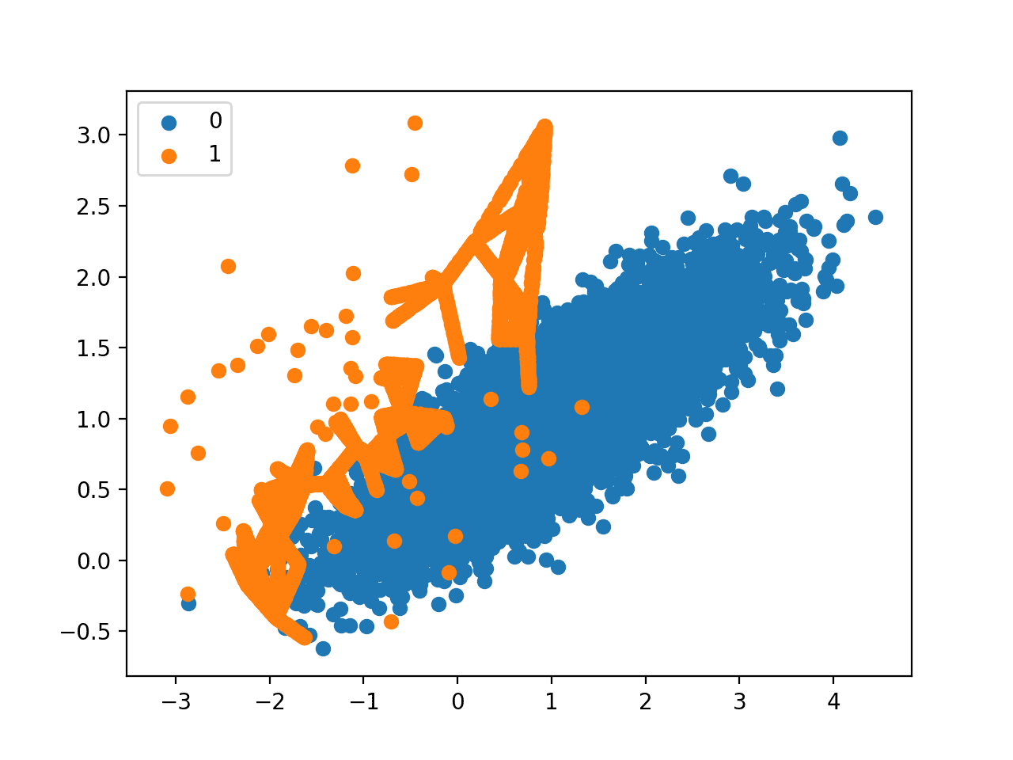
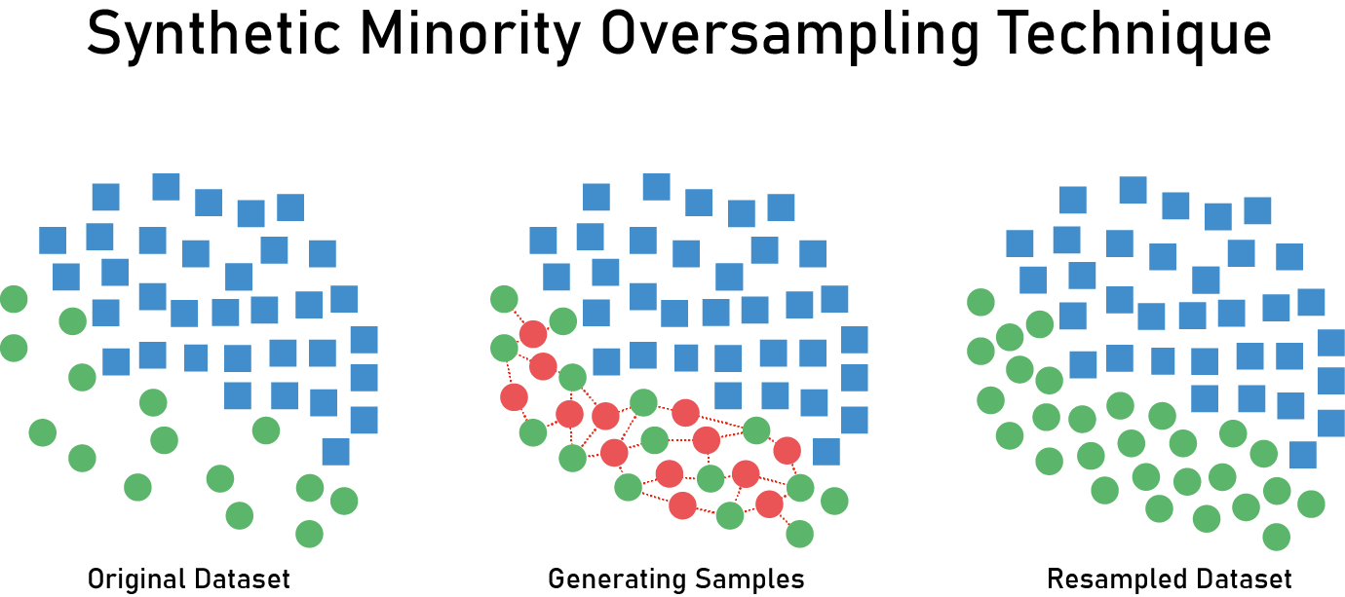
SMOTE works by selecting examples that are close in the feature space, drawing a line between the examples in the feature space and drawing a new sample at a point along that line. Specifically, a random example from the minority class is first chosen.

